Slide 1


Oeson Learning Global Training & Internship Program (OGTIP)
Project 1
By
J. Michael Barbiere
01/27/2024

Slide 2

Charts & Descriptive Statistics
General Stock Trends -- 2018 - 2023

Slide 3
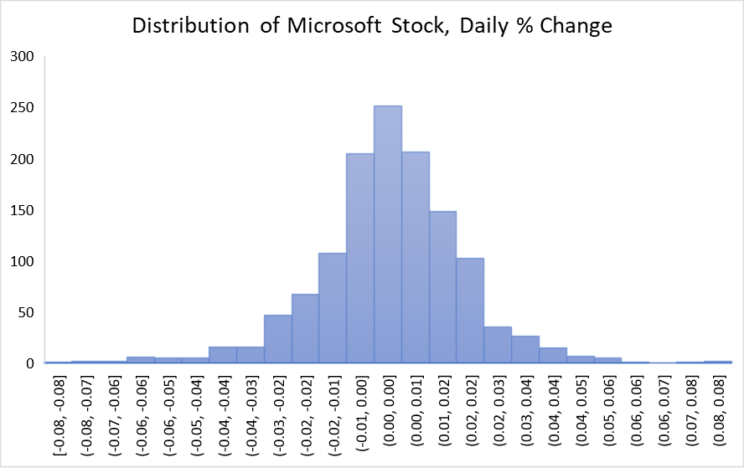
Microsoft (MSFT) Analysis
MS%chng
Mean | 0.000979958
Standard Error | 0.000504167
Median | 0.001226943
Mode | #N/A
Standard Deviation | 0.018016473
Sample Variance | 0.000324593
Kurtosis | 2.377098634
Skewness | -0.213391547
Range | 0.168714945
Minimum | -0.084074871
Maximum | 0.084640074
Sum | 1.251405994
Count | 1277

Slide 4
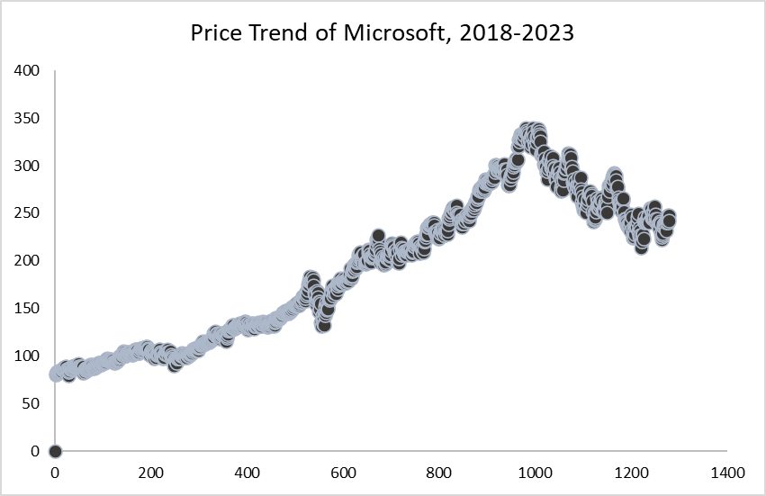

Slide 5
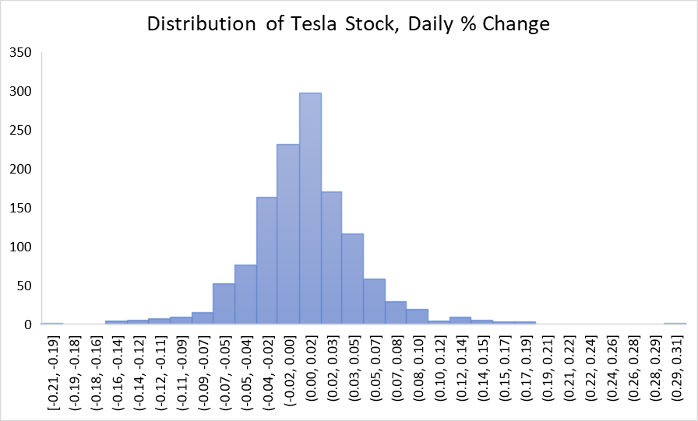
Tesla (TSLA) Analysis
Tesl%chng
Mean | 0.002625015
Standard Error | 0.00122056
Median | 0.001981709
Mode | 0
Standard Deviation | 0.043616865
Sample Variance | 0.001902431
Kurtosis | 4.115033068
Skewness | 0.413470908
Range | 0.521556883
Minimum | -0.210924421
Maximum | 0.310632462
Sum | 3.352144439
Count | 1277

Slide 6
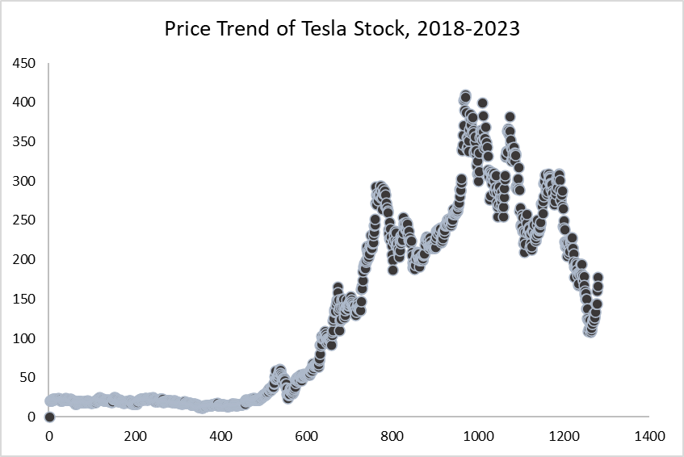

Slide 7
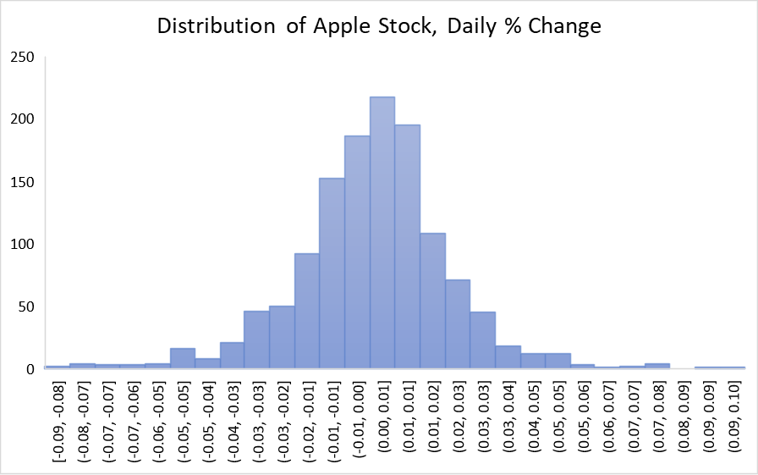
Apple (AAPL) Analysis
App%chng
Mean | 0.001174999
Standard Error | 0.000579216
Median | 0.001992699
Mode | #N/A
Standard Deviation | 0.02069837
Sample Variance | 0.000428423
Kurtosis | 2.480630179
Skewness | -0.151267285
Range | 0.183857717
Minimum | -0.086602056
Maximum | 0.097255661
Sum | 1.500473993
Count | 1277

Slide 8
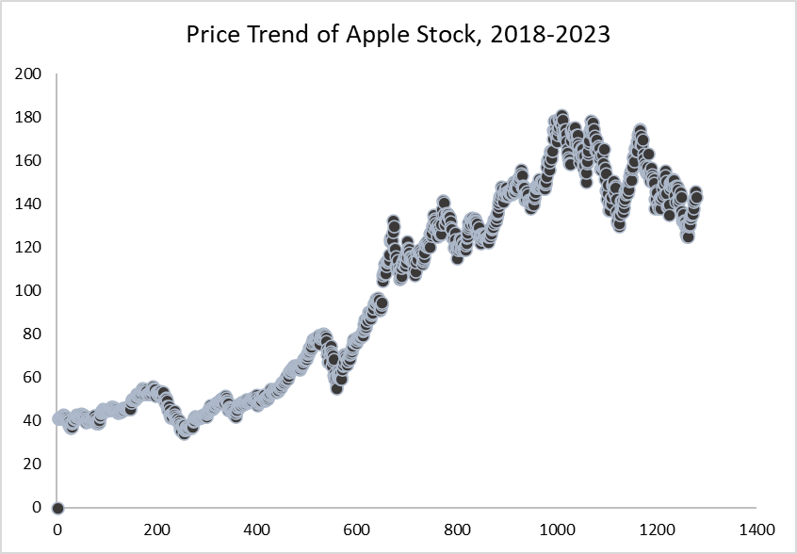

Slide 9
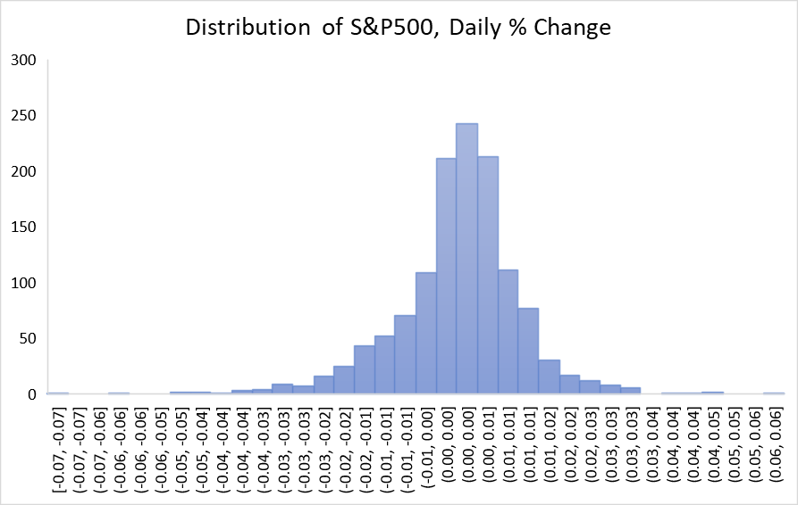
S&P 500 Analysis
SP%chng
Mean | 0.000255938
Standard Error | 0.000322613
Median | 0.001165985
Mode | #N/A
Standard Deviation | 0.011528603
Sample Variance | 0.000132909
Kurtosis | 4.194610964
Skewness | -0.652103898
Range | 0.132579471
Minimum | -0.074021423
Maximum | 0.058558049
Sum | 0.326832892
Count | 1277

Slide 10
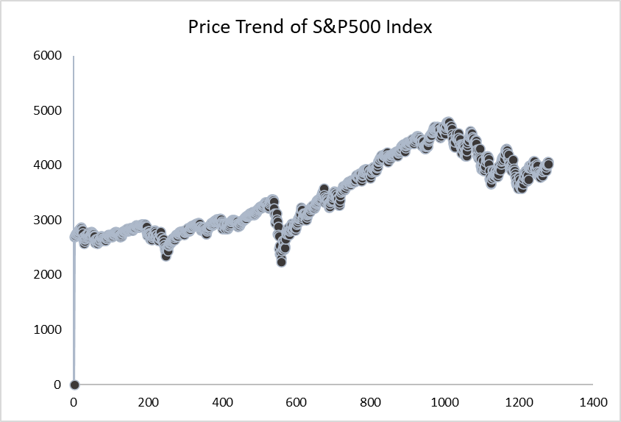

Slide 11

Regressions Analysis of Slope Coefficient (Beta)
Impact of S&P500 Index on the individual stocks' performances.

Slide 12
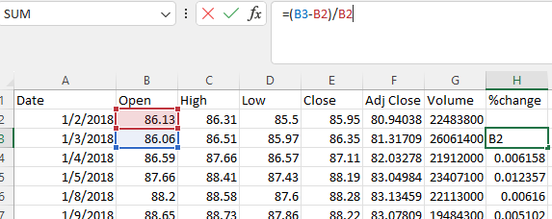
Identifying Variables
Target Variable:
% Change in Opening Stock Price; or Difference in Priced Value from Day to Day.
Independent Variable:
The broader movement of the S&P500; and what influence that has on a particular stock.

Slide 13
MSFT Stock Regression Analysis
MSFT Beta
Regression Statistics
Multiple R | 0.776761859
R Square | 0.603358986
Adjusted R Square | 0.603047895
Standard Error | 0.011351123
Observations | 1277
ANOVA
 | df | SS | MS | F | Significance F
Regression | 1 | 0.2499 | 0.2499 | 1939.494 | 2.7E-258
Residual | 1275 | 0.164281 | 0.000129
Total | 1276 | 0.414181
 | Coefficients | Standard Error | t Stat | P-value | Lower 95% | Upper 95% | Lower 95.0% | Upper 95.0%
Intercept | 0.000669271 | 0.000318 | 2.106453 | 0.03536 | 4.6E-05 | 0.001293 | 4.6E-05 | 0.001293
SP%chng | 1.213894549 | 0.027564 | 44.03968 | 2.7E-258 | 1.159819 | 1.26797 | 1.159819 | 1.26797
The slope of Input Variable is a positive value: 1.213.
This suggests some correlation associated with the price of MSFT.

Slide 14
TSLA Stock Regression Analysis
TSLA Beta
Regression Statistics
Multiple R | 0.480470481
R Square | 0.230851884
Adjusted R Square | 0.23024863
Standard Error | 0.038267464
Observations | 1277
ANOVA
 | df | SS | MS | F | Significance F
Regression | 1 | 0.560393 | 0.560393 | 382.6781 | 9.95E-75
Residual | 1275 | 1.867108 | 0.001464
Total | 1276 | 2.427502
 | Coefficients | Standard Error | t Stat | P-value | Lower 95% | Upper 95% | Lower 95.0% | Upper 95.0%
Intercept | 0.002159771 | 0.001071 | 2.016353 | 0.043972 | 5.84E-05 | 0.004261 | 5.84E-05 | 0.004261
SP%chng | 1.817793136 | 0.092924 | 19.56216 | 9.95E-75 | 1.635492 | 2.000094 | 1.635492 | 2.000094
The slope of Input Variable is a positive value: 1.817.
This suggests some correlation associated with the price of TSLA.

Slide 15
APPL Stock Regression Analysis
APPL Beta
Regression Statistics
Multiple R | 0.740342976
R Square | 0.548107722
Adjusted R Square | 0.547753296
Standard Error | 0.013919507
Observations | 1277
ANOVA
 | df | SS | MS | F | Significance F
Regression | 1 | 0.299632 | 0.299632 | 1546.469 | 3.7E-222
Residual | 1275 | 0.247035 | 0.000194
Total | 1276 | 0.546667
 | Coefficients | Standard Error | t Stat | P-value | Lower 95% | Upper 95% | Lower 95.0% | Upper 95.0%
Intercept | 0.0008348 | 0.00039 | 2.142628 | 0.032332 | 7.04E-05 | 0.001599 | 7.04E-05 | 0.001599
SP%chng | 1.329206365 | 0.0338 | 39.32517 | 3.7E-222 | 1.262896 | 1.395517 | 1.262896 | 1.395517
The slope of Input Variable is a positive value: 1.329.
This suggests some correlation associated with the price of APPL.

Slide 16
Comparison of Beta Values
Each of these three popular stocks have a P-Value and F-Significance that's significantly small. We can safely reject the null hypothesis for each of these three; however, they have varying R-Squared values.
Therefore, other variables should be taken into consideration when considering purchasing any of these stocks (aside from the Beta coefficient).
Also, TSLA appears to be the most volatile, with the highest Beta slope coefficient, and the lowest R-Squared value.
 | MSFT | TSLA | AAPL
SLOPE | 1.213 | 1.817 | 1.329
R Squared | 0.603 | 0.230 | 0.548
F-Significance | 2.7E-258 | 9.95E-75 | 3.7E-222
P-Value | 2.7E-258 | 9.95E-75 | 3.7E-222

Slide 17

Multi-Linear Regression
Do Individual Stocks have an effect on the Price of S&P 500 Index?

Slide 18
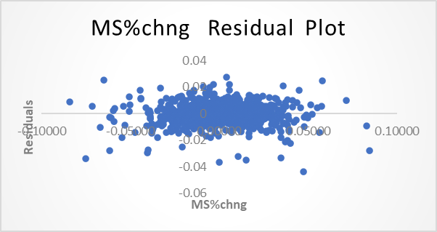
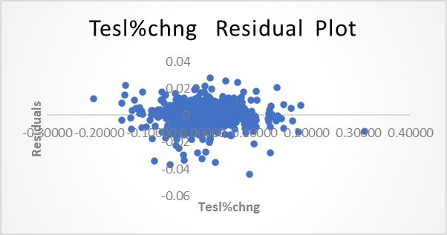
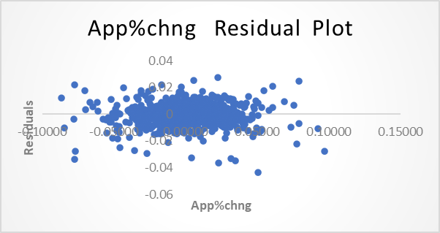
SUMMARY OUTPUT
Regression Statistics
Multiple R | 0.815234
R Square | 0.664606
Adjusted R Square | 0.663816
Standard Error | 0.006684
Observations | 1277
ANOVA
 | df | SS | MS | F | Significance F
Regression | 3 | 0.112712 | 0.037571 | 840.8463 | 2.4E-301
Residual | 1273 | 0.05688 | 4.47E-05
Total | 1276 | 0.169591
 | Coefficients | Standard Error | t Stat | P-value | Lower 95% | Upper 95% | Lower 95.0% | Upper 95.0%
Intercept | -0.00033 | 0.000187 | -1.7347 | 0.083037 | -0.00069 | 4.26E-05 | -0.00069 | 4.26E-05
MS%chng | 0.311332 | 0.016023 | 19.43012 | 7.49E-74 | 0.279897 | 0.342767 | 0.279897 | 0.342767
Tesl%chng | 0.022272 | 0.005022 | 4.435195 | 9.99E-06 | 0.01242 | 0.032123 | 0.01242 | 0.032123
App%chng | 0.185221 | 0.01413 | 13.10825 | 6.46E-37 | 0.1575 | 0.212942 | 0.1575 | 0.212942

Slide 19
Thank you!
Mike Barbiere
Barbj3799@gmail.com

